Slide 1

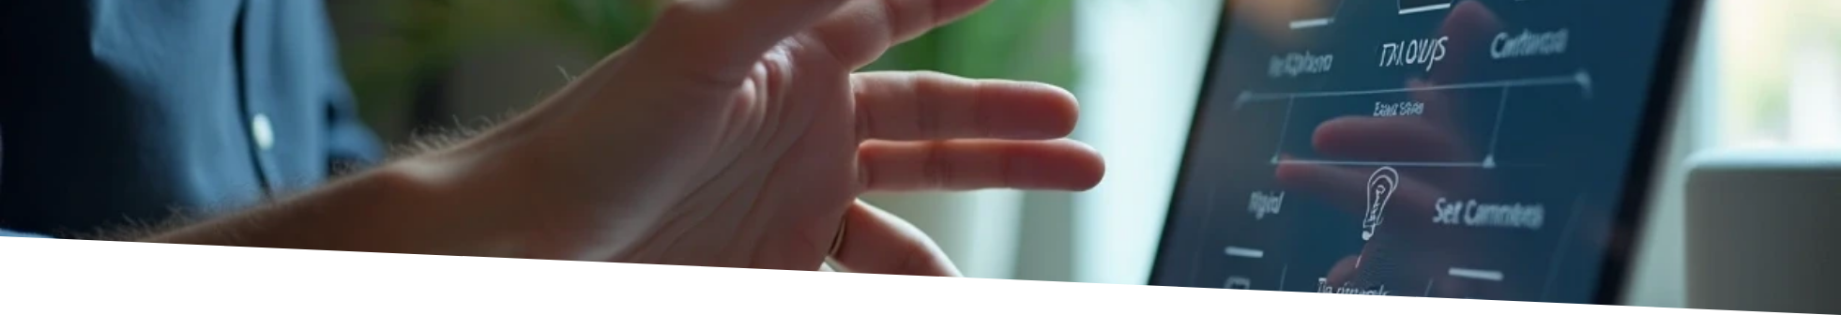
Hand Gesture Control for Device Interaction
This presentation delves into a final year major project that harnesses hand gestures for controlling laptops and home automation systems. By implementing various Python libraries, the project enables effective gesture recognition and seamless device control, enhancing user interaction and convenience in technology.

Slide 2
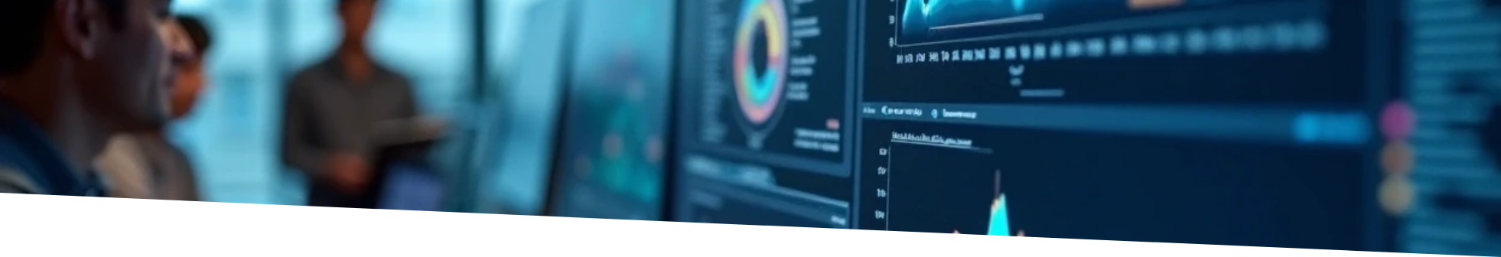

Introduction to Computer Vision
Computer vision is transforming how we interact with technology, enabling machines to interpret visual data and recognize human gestures. This capability not only enhances accessibility but also makes technology more intuitive and user-friendly.
What is Computer Vision?
Gesture Recognition
Importance in Automation
A field of AI enabling computers to understand visual data.
Technology for detecting and interpreting human gestures.
Enhances accessibility and user-friendliness of technology.

Slide 3



Project Overview
Components
2
Includes camera, gesture recognition software, and control modules.
Objective
1
Create a system for controlling devices via hand gestures.
3
Use Cases
Applications include media playback and smart home control.

Slide 4
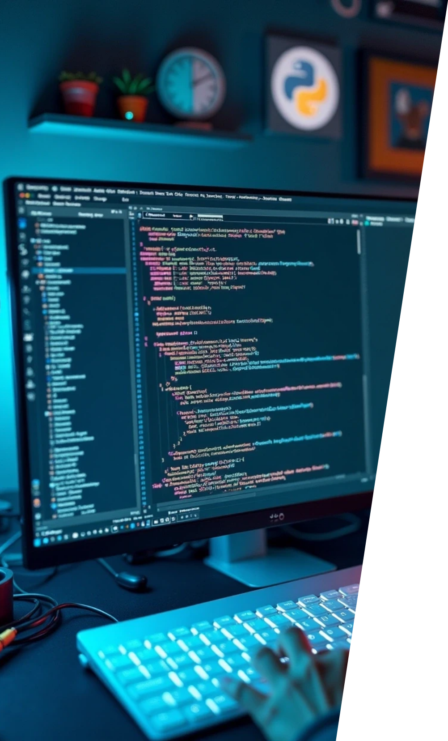


Python Libraries Used
OpenCV
MediaPipe
NumPy
Fundamental library for image processing.
For hand tracking and gesture recognition.
Aids in numerical operations and data manipulation.
PyAutoGUI
TensorFlow/Keras
Automates keyboard and mouse movements.
Deep learning capabilities for custom models.

Slide 5



Implementation Steps for Gesture Recognition System
1
2
3
4
Setting Up the Environment
Gesture Detection Algorithm
Integration with Devices
Testing and Refinement
Installing necessary libraries and dependencies ensures a smooth development process.
Developing a robust algorithm that captures hand positions and recognizes specific gestures.
Establishing connections between the gesture recognition framework and the devices.
Conducting comprehensive testing to improve accuracy and responsiveness based on real-world usage.

Slide 6



Challenges Faced
User Variability
Different users may have varying hand sizes and styles of gestures, which can complicate uniform gesture recognition.
Latency Issues
Environmental Variability
Ensuring real-time response to gestures while processing video feed is critical, as any noticeable delay can disrupt user experience.
Variations in lighting and background can significantly affect gesture recognition accuracy, necessitating adaptive solutions.
2
1
3

Slide 7

Future Work on Gesture Recognition System
User Feedback Incorporation
Expanding Gesture Set
Gathering feedback from users can help identify areas for improvement in the gesture recognition system and overall user experience.
Adding more complex gestures and customizable user-defined gestures will broaden the system's versatility and usability.
Integration with AI
Mobile and Web Applications
Incorporating machine learning algorithms can improve recognition accuracy and adaptability over time, learning from user interactions.
Extending the functionality to mobile and web platforms for broader accessibility and convenience in smart home control.

Slide 8





Conclusion of the Project
This project demonstrates how computer vision and automation converge through the use of hand gestures, utilizing diverse Python libraries to improve user interaction with technology. The results suggest a bright future for gesture-based control systems, which could lead to greater accessibility and groundbreaking innovations in user interface design for daily technology.
1
2
Project Overview
Technological Tools
This project showcases the intersection of computer vision and automation through hand gestures.
Equipped with various Python libraries to enhance interaction with technology.
3
4
Future Prospects
Innovative Interfaces
The findings indicate a promising future for gesture-based control systems.
Paving the way for increased accessibility and innovative user interfaces in everyday technology.

